Slide 1


Slide 2


Slide 3
Lesson - 5 App Architecture and Dependency Injection

Slide 4
WHOLENESS OF THE LESSON
This lesson integrates app architecture, ViewModel state management, unit testing, and dependency injection with Hilt into one cohesive framework that strengthens clarity, reliability, and usability. Science and Technology of Consciousness: Just as knowledge is structured in consciousness, where the whole supports and gives meaning to each part, the structure of an app integrates architecture, testing, and UI so every layer contributes to the wholeness of the system.

Slide 5
Agenda
App Architecture
Unit Testing for ViewModel
Dependency injection with Hilt
More UIs
RadioButton
Checkbox

Slide 6
Mobile App Architecture
Learn about app architecture and how to use ViewModels, UI State, and StateFlow to build more complex apps.

Slide 7
App Architecture
Separation of concerns
The separation of concerns design principle states that the app is divided into classes of functions, each with separate responsibilities.
Drive UI from a model
The drive UI from a model principle states that you should drive your UI from a model, preferably a persistent model.
Models are components responsible for handling the data for an app.
Models are independent from the UI elements and app components in your app, so they're unaffected by the app's lifecycle and associated concerns.
Notes:
The most common architectural principles are separation of concerns and driving UI from a model.
In modern Android architecture, "drive UI from a model" refers to using a ViewModel to hold and manage the UI state, which acts as the model for the user interface.

Slide 8
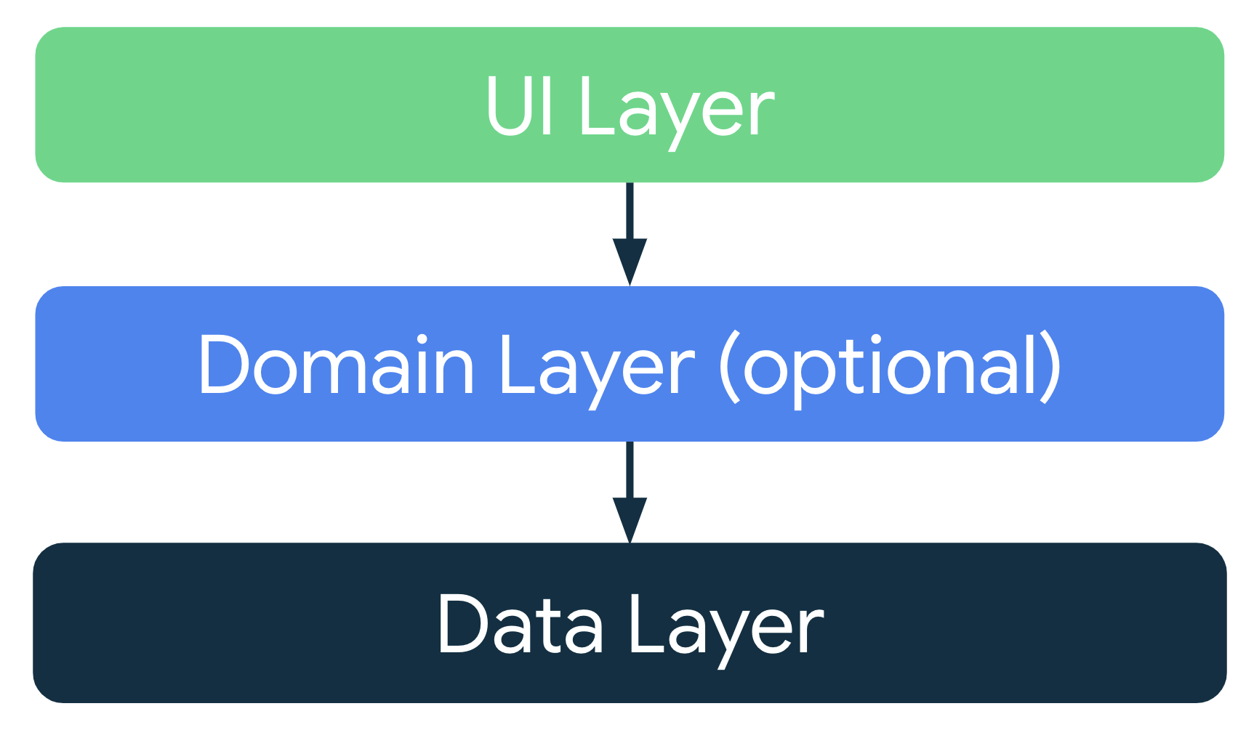
Recommended app architecture
App should have at least two layers:
UI layer
a layer that displays the app data on the screen but is independent of the data.
Data layer
a layer that stores, retrieves, and exposes the app data.
You can add an additional layer called the domain layer to simplify and reuse the interactions between the UI and data layers.

Slide 9
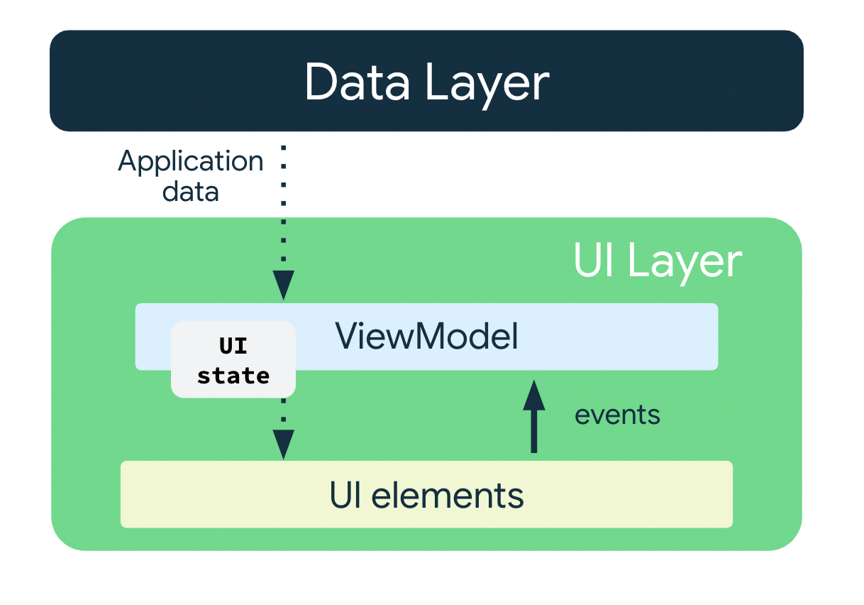
UI Layer
The role of the UI layer, or presentation layer, is to display the application data on the screen.
Whenever the data changes due to a user interaction, such as pressing a button, the UI should update to reflect the changes.

Slide 10
UI Layer
The UI layer is made up of the following components:
UI elements
components that render the data on the screen. You build these elements using Jetpack Compose.
State holders
components that hold the data, expose it to the UI, and handle the app logic. An example state holder is ViewModel.

Slide 11
ViewModel
The ViewModel component holds and exposes the state the UI consumes.
The UI state is application data transformed by ViewModel.
ViewModel lets the app follow the architecture principle of driving the UI from the model.

Slide 12
Do not mix Logic with View
Separation of Concern

Slide 13


@Composable fun MainScreen(modifier: Modifier = Modifier) {
var counter = remember { mutableIntStateOf(0) } var increment = { counter.value++ } var decrement = { counter.value-- }
Column( modifier = modifier.fillMaxSize(), //.. ) { Button(onClick = { increment() }) { Text(text = "Increment") } Text(text = "${counter.value}") Button(onClick = { decrement() }) { Text(text = "Decrement") } } }
Logic
View

Slide 14
rememberSaveable{ }
While remember{ } helps you retain state across recompositions, the state is not retained across configuration changes.
For this, you must use rememberSaveable.
rememberSaveable automatically saves any value that can be saved in a Bundle.

Slide 15
@Composable fun MainScreen(modifier: Modifier = Modifier) {
var counter = rememberSaveable { mutableIntStateOf(0) } var increment = { counter.value++ } var decrement = { counter.value-- }
Column( modifier = modifier.fillMaxSize(), //.. ) { Button(onClick = { increment() }) { Text(text = "Increment") } Text(text = "${counter.value}") Button(onClick = { decrement() }) { Text(text = "Decrement") } } }
Logic
View

Slide 16
Separate Logic and View
Separation of Concern

Slide 17
Create a ViewModel class for Logic
class MainScreenViewModel: ViewModel() {
}
dependencies { implementation("androidx.lifecycle:lifecycle-viewmodel-compose-android:2.9.3") //… }

Slide 18
ViewModel
ViewModel keeps app data safe
It stores data that does not get lost when the app’s activity is destroyed and recreated.
ViewModel objects are durable
Unlike activity instances, ViewModel objects are not destroyed.
Automatic data retention
The app keeps ViewModel objects during configuration changes, so the data is ready right away after the app is rebuilt.

Slide 19
Expose read-only data from ViewModel
class MainScreenViewModel: ViewModel() { private var _counter = MutableStateFlow(0) val counter = _counter.asStateFlow()
//… }
It is a type of StateFlow that allows its value to be updated.
This converts the MutableStateFlow _counter to a read-only StateFlow using the asStateFlow() extension function.
This means that while _counter can be updated within the MainActivityViewModel, external classes can only observe its value through counter and cannot modify it.

Slide 20
Include lambda(s) for increment & decrement
class MainScreenViewModel: ViewModel() { private var _counter = MutableStateFlow(0) val counter = _counter.asStateFlow() var increment = { _counter.value = _counter.value.plus(1) } var decrement = { _counter.value = _counter.value.minus(1) } }

Slide 21
Integrating StateFlow with Compose
Use collectAsState() to convert a StateFlow into a Compose State.
Ensures the UI automatically updates when the StateFlow emits new values.
Provides seamless integration between Kotlin coroutines and Jetpack Compose.
Maintains lifecycle-awareness, preventing memory leaks and ensuring efficient state management.

Slide 22
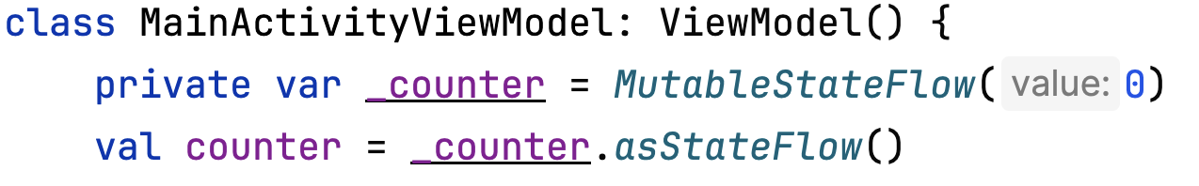
Integrating StateFlow with Compose
Use collectAsState() to convert a StateFlow into a Compose State.
Ensures the UI automatically updates when the StateFlow emits new values.
Provides seamless integration between Kotlin coroutines and Jetpack Compose.
Maintains lifecycle-awareness, preventing memory leaks and ensuring efficient state management.
@Composable fun MainScreen( modifier: Modifier = Modifier, mainScreenViewModel : MainScreenViewModel = viewModel() ) {
val countState = mainScreenViewModel.counter.collectAsState()
//…
}

Slide 23
Integrating StateFlow with Compose
@Composable fun MainScreen( modifier: Modifier = Modifier, mainScreenViewModel: MainScreenViewModel = viewModel() ) {
val countState = mainScreenViewModel.counter.collectAsState()
Column( //… ) { Button(onClick = {mainScreenViewModel.increment() }) { Text(text = "Increment") }
Text(text = "${countState.value}")
Button(onClick = {mainScreenViewModel.decrement() }) { Text(text = "Decrement") } } }
1
2

Slide 24

UI State
The UI is what the user sees, and the UI state is what the app says they should see.
The UI is the visual representation of the UI state.
Any changes to the UI state immediately are reflected in the UI.

Slide 25
UI State
Keep UI State as immutable.
Immutable objects guarantee that multiple sources do not alter the state of the app at an instant in time.
This protection frees the UI to focus on a single role: reading state and updating UI elements accordingly.

Slide 26
Create a data class for UIState
data class CounterUIState( val isLoading: Boolean = false, val counter: Int = 0, val errorMessage: String? = null )
This flag indicates whether the app is currently performing a task, like fetching data. It helps manage the UI, such as showing a loading spinner to the user.
This represents the current value of the counter. It’s the main data point that the UI will display and update.
This optional string holds any error messages that might occur. If something goes wrong, this can be used to show an error message to the user.

Slide 27
Refactor the code in MainScreenViewModel
private var _counter = MutableStateFlow(0)
private var _counter = MutableStateFlow(CounterUIState(isLoading = false))
Notes:
Initial value is available locally (like a counter starting at 0) → start with isLoading = false.
Initial value must be fetched (DB, API, async work) → start with isLoading = true.

Slide 28
Refactor the code in MainScreenViewModel
var increment = { viewModelScope.launch { _counter.value = _counter.value.plus(1) } }
var increment = { viewModelScope.launch { _counter.value.let { _counter.value = it.copy(counter = it.counter.plus(1), errorMessage = null) } } }
Similarly, do it for decrement.

Slide 29
Refactor the code in MainScreenViewModel
var decrement = { viewModelScope.launch { _counter.value = _counter.value.minus(1) } }
var decrement = { viewModelScope.launch { if (_counter.value.counter == 0) { _counter.value = CounterUIState(errorMessage = "Counter cannot be less than 0") return@launch } _counter.value.let { _counter.value = it.copy(counter = it.counter.minus(1)) } } }

Slide 30
Simulate loading in MainScreenViewModel
init { viewModelScope.launch { // Simulate loading state for 2 seconds delay(2000L) _counter.value = CounterUIState(isLoading = false, counter = 0) } }

Slide 31
class MainScreenViewModel: ViewModel() { private var _counter = MutableStateFlow(CounterUIState(isLoading = true)) val counter = _counter.asStateFlow() init { viewModelScope.launch { // Simulate loading state for 2 seconds delay(2000L) _counter.value = CounterUIState(isLoading = false, counter = 0) } } var increment = { viewModelScope.launch { _counter.value.let { _counter.value = it.copy(counter = it.counter.plus(1)) } } } var decrement = { viewModelScope.launch { _counter.value.let { _counter.value = it.copy(counter = it.counter.minus(1)) } } } }
Refactored MainScreenViewModel

Slide 32
Refactor the code in MainScreen
Column( //… ) { Button(onClick = { /*…*/ }) { Text(text = "Increment") }
Text(text = "${countState.value}")
Button(onClick = {/*…*/ }) { Text(text = "Decrement") } }
val state = countState.value when { state.isLoading -> { CircularProgressIndicator() } state.errorMessage != null -> { Text(text = state.errorMessage) } else -> { Text(text = "${state.counter}") } }

Slide 33
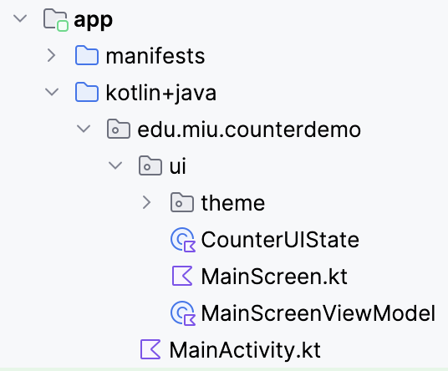
Package Hierarchy & Output
https://github.com/brightgeevarghese/CounterDemo.git

Slide 34
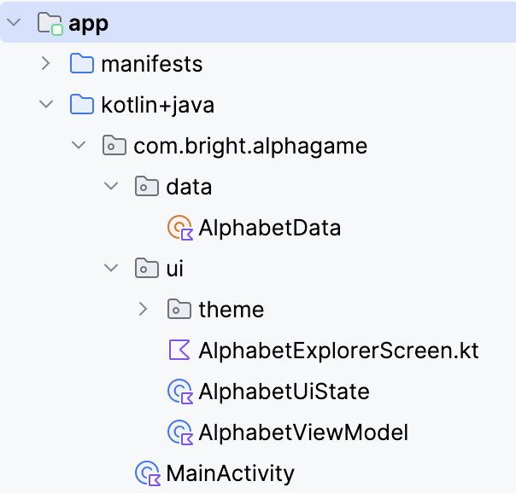
Create an alphabet explorer app which incorporates the recommended architecture

Slide 35
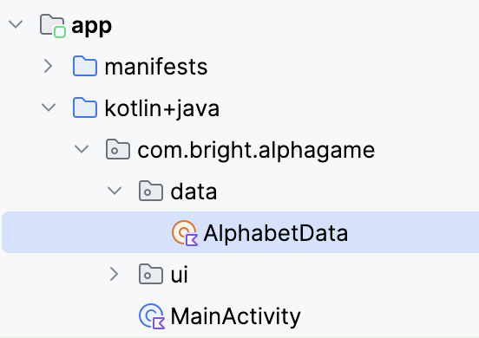
Create a data package to hold the data source
object AlphabetData{ val alphabets = listOf<Pair<Char, String>>( 'A' to "Alpha", 'B' to "Bravo", 'C' to "Charlie", 'D' to "Delta", 'E' to "Echo", … 'V' to "Victor", 'W' to "Whiskey", 'X' to "X-ray", 'Y' to "Yankee", 'Z' to "Zulu" ) }

Slide 36
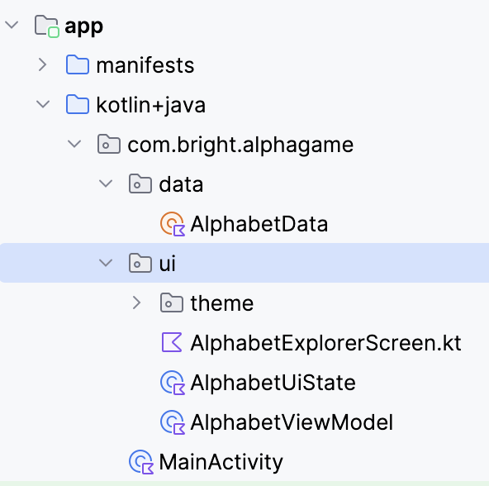
Use the ui package to hold the ViewModel, UIState, and Composable function

Slide 37
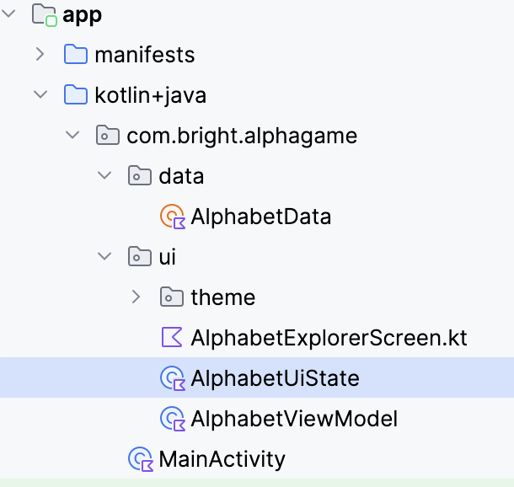
Create a class for UIState
data class AlphabetUIState( val currentAlphabet: Char, val currentWord: String, val isLoading: Boolean = false, val isError: Boolean = false, val isCompleted: Boolean = false )

Slide 38
Create ViewModel class
class AlphabetViewModel: ViewModel() { // Retrieve the list of alphabet pairs from the data source private val alphabets = AlphabetData.alphabets private val _alphabetUIState = MutableStateFlow( AlphabetUIState( currentAlphabet = alphabets[0].first, currentWord = alphabets[0].second, isLoading = false, isError = false, isCompleted = true ) ) // Expose _alphabetUIState as a read-only StateFlow to be observed by UI components val alphabetUIState = _alphabetUIState.asStateFlow()
//…
}

Slide 39
Include a fun in ViewModel class to find the next pair
fun nextAlphabet() { val currentIndex = alphabets.indexOf( _alphabetUIState.value.currentAlphabet to _alphabetUIState.value.currentWord ) if (currentIndex < alphabets.size - 1) { val nextAlphabet = alphabets[currentIndex + 1] _alphabetUIState.value = _alphabetUIState.value.copy( currentAlphabet = nextAlphabet.first, currentWord = nextAlphabet.second, isLoading = false, isError = false, isCompleted = true ) } else if (currentIndex == alphabets.size - 1) { _alphabetUIState.value = _alphabetUIState.value.copy( currentAlphabet = alphabets[0].first, currentWord = alphabets[0].second ) } }

Slide 40
Create a composable fun
@Composable fun AlphabetExplorerScreen( modifier: Modifier = Modifier, alphabetViewModel: AlphabetViewModel = viewModel() ) { val alphabetUIState by alphabetViewModel.alphabetUIState.collectAsState() Column( /*…*/ ) { val alphabet = alphabetUIState.currentAlphabet val word = alphabetUIState.currentWord when { alphabetUIState.isLoading -> { Text(text = "Loading...") } alphabetUIState.isError -> { Text(text = "Error loading alphabets") } alphabetUIState.isCompleted -> { Text(text = "$alphabet for $word") } } Button(onClick = { alphabetViewModel.nextAlphabet() }) { Text(text = "Next Alphabet") } } }

Slide 41
UI elements + UI State + ViewModel + Data
https://github.com/brightgeevarghese/AlphabetExplorer.git

Slide 42

Repository Pattern

Slide 43
Repository Pattern
Without Repository
The ViewModel directly accesses the database or API.
Leads to tight coupling and duplicate data-handling code.
Difficult to test or replace data sources later.
With Repository
The ViewModel depends only on the Repository interface.
Repository decides where data comes from (local DB, remote API, or both).
Promotes Clean Architecture and single responsibility.

Slide 44
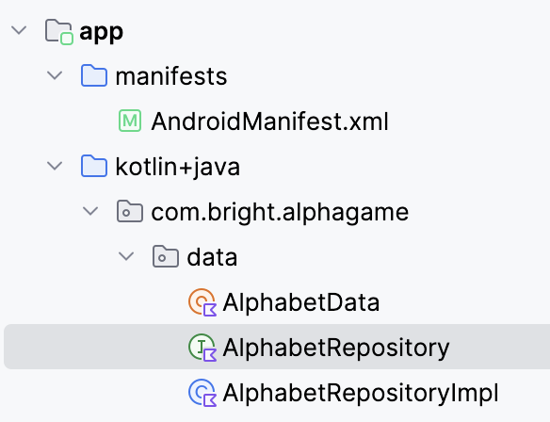
Create a Repository
interface AlphabetRepository { fun getAlphabets(): List<Pair<Char, String>> fun getNextAlphabet(currentAlphabet: Pair<Char, String>): Pair<Char, String> }

Slide 45
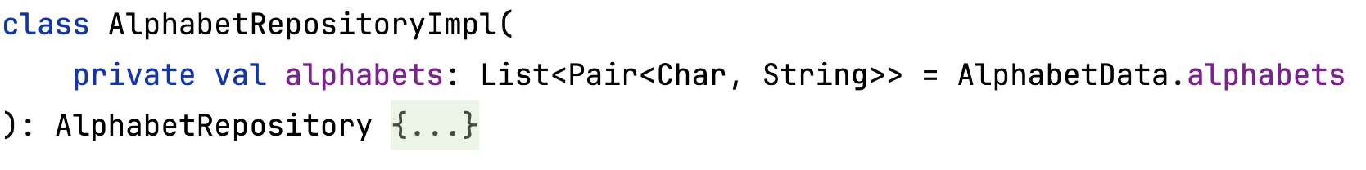
Implement the Repository

Slide 46
Implement the Repository
override fun getAlphabets(): List<Pair<Char, String>> = alphabets override fun getNextAlphabet(currentAlphabet: Pair<Char, String>): Pair<Char, String> { val currentIndex = AlphabetData.alphabets.indexOf(currentAlphabet) if (currentIndex < AlphabetData.alphabets.size - 1) { return AlphabetData.alphabets[currentIndex + 1] } else { return AlphabetData.alphabets.first() } }

Slide 47
Include repository as a constructor parameter
class AlphabetViewModel ( val alphabetRepository: AlphabetRepository ): ViewModel() { // private val alphabets = AlphabetData.alphabets private val alphabets = alphabetRepository.getAlphabets()
//…
}

Slide 48
Unit Testing
To test the ViewModel

Slide 49
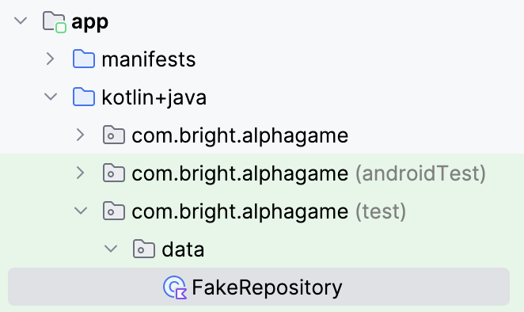
Set up a Fake Repository
class FakeRepository( alphabets: List<Pair<Char, String>> = listOf( 'A' to "Alpha", 'B' to "Bravo", 'C' to "Charlie" ) ): AlphabetRepository by AlphabetRepositoryImpl(alphabets) // The class delegates all functionality to AlphabetRepositoryImpl // using Kotlin’s delegation feature (the by keyword).

Slide 50
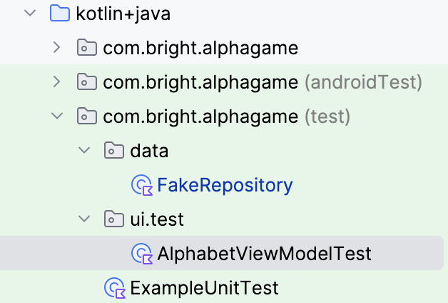
Create a Test class, AlphabetViewModelTest
class AlphabetViewModelTest { private lateinit var viewModel: AlphabetViewModel
@Before fun setup() { viewModel = AlphabetViewModel(FakeRepository()) } //… }

Slide 51
Write a test to check initial state
@Test fun testInitialUiState() { val uiState = viewModel.alphabetUiState.value assert(uiState.currentChar == 'A') assert(uiState.currentWord == "Alpha") }

Slide 52
Write a test to check the next alphabet after initial state
@Test fun testNextAlphabet() { viewModel.getNextAlphabet() val uiState = viewModel.alphabetUiState.value assert(uiState.currentChar == 'B') assert(uiState.currentWord == "Bravo") }

Slide 53
Write a test to check the completed alphabet
@Test fun testCompletedAlphabet() { repeat(2) { viewModel.getNextAlphabet() } val uiState = viewModel.alphabetUiState.value assert(uiState.isCompleted) }
class FakeRepository( alphabets: List<Pair<Char, String>> = listOf( 'A' to "Alpha", 'B' to "Bravo", 'C' to "Charlie" ) ): AlphabetRepository by AlphabetRepositoryImpl(alphabets)

Slide 54
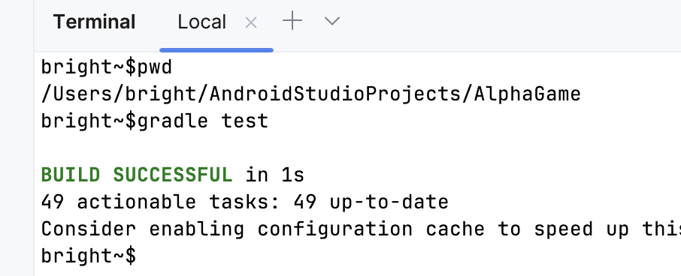
Run all test cases
Go to the project folder

Slide 55
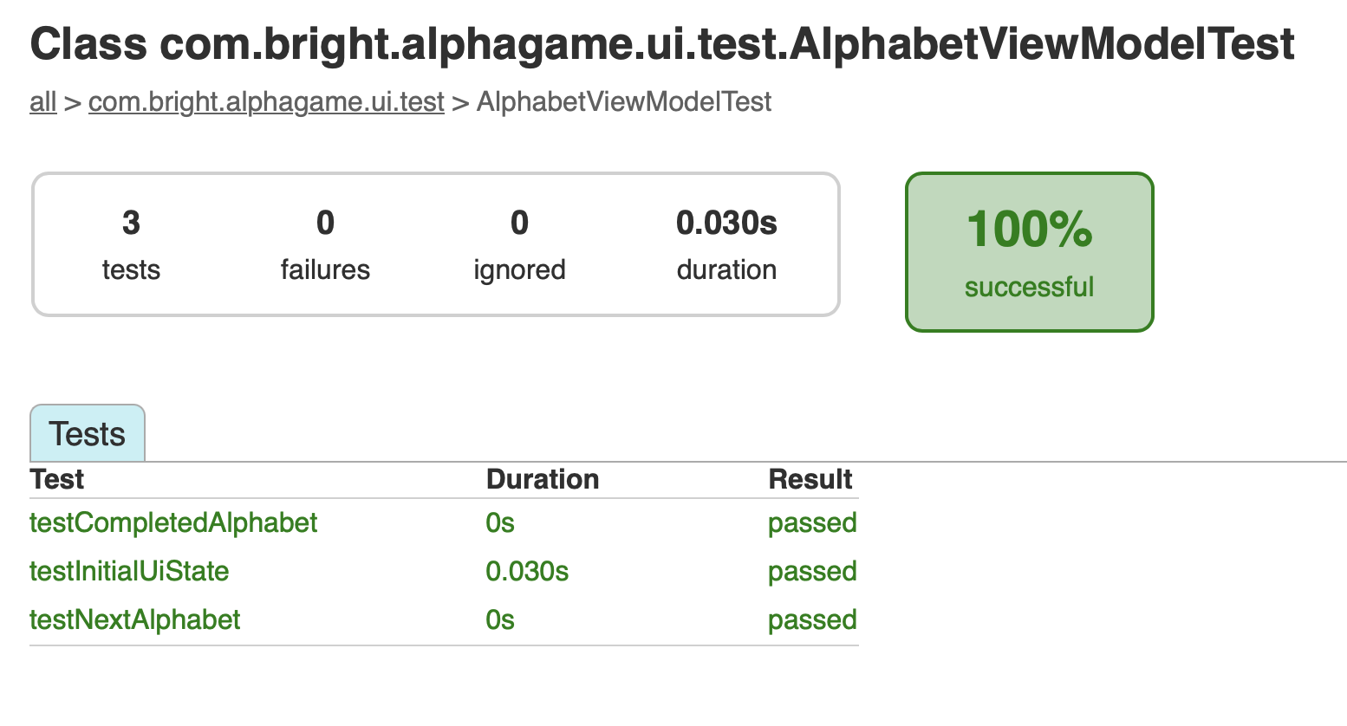
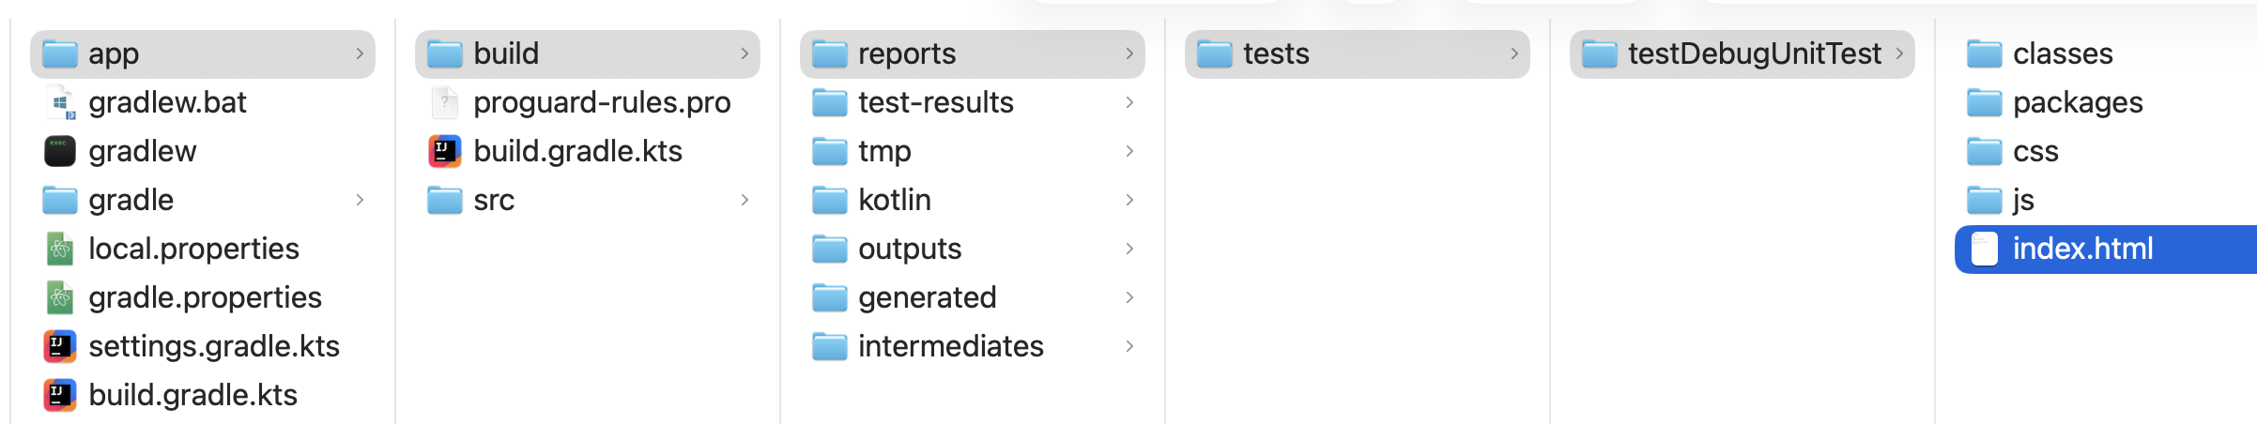
Examine the test report
Notes:
Source Code: https://github.com/brightgeevarghese/AlphaGame.git

Slide 56
Dependency injection with Hilt
goo.gle/hilt-cheatsheet

Slide 57
Hilt
Definition
Hilt is a dependency injection (DI) library for Android.
Built on top of Dagger, designed specifically for Android to reduce boilerplate.
Why Use Hilt?
Simplifies the process of dependency injection.
Provides a standard way to handle dependencies in Android apps.
Hilt is Jetpack’s recommended DI.

Slide 58
Setting Up Hilt
// Top-level build file where you can add configuration options common to all sub-projects/modules. plugins { alias(libs.plugins.android.application) apply false alias(libs.plugins.kotlin.android) apply false alias(libs.plugins.kotlin.compose) apply false // Hilt plugin for Dependency Injection // but not applied globally (apply false). // Keeps it available for modules that explicitly need it. id("com.google.dagger.hilt.android") version "2.57.2" apply false // Kotlin Symbol Processing (KSP) plugin // Applied immediately at the root with version "2.2.10-2.0.2". // Required to run annotation processors (e.g., Room, Moshi, Hilt codegen). id("com.google.devtools.ksp") version "2.2.10-2.0.2" apply false }
Add the hilt-android-gradle-plugin plugin to your project's root build.gradle file:
Notes:
// Hilt plugin for Dependency Injection // but not applied globally (apply false). // Keeps it available for modules that explicitly need it. id("com.google.dagger.hilt.android") version "2.57.2" apply false // Kotlin Symbol Processing (KSP) plugin // Applied immediately at the root with version "2.2.20-2.0.3". // Required to run annotation processors (e.g., Room, Moshi, Hilt codegen). id("com.google.devtools.ksp") version "2.2.20-2.0.3"

Slide 59
import org.jetbrains.kotlin.gradle.dsl.JvmTarget plugins { //… id("com.google.devtools.ksp") id("com.google.dagger.hilt.android") } android { // kotlinOptions { // jvmTarget = "11" // } kotlin { compilerOptions { jvmTarget.set(JvmTarget.JVM_11) } } } dependencies { implementation("com.google.dagger:hilt-android:2.57.2") //dependency for hiltViewModel() implementation("androidx.hilt:hilt-navigation-compose:1.3.0") ksp("com.google.dagger:hilt-android-compiler:2.57.2") implementation("androidx.lifecycle:lifecycle-viewmodel-compose:2.9.4") //… }
Setting Up Hilt
Apply the Gradle plugin and add these dependencies in your app/build.gradle file:
Notes:
import org.jetbrains.kotlin.gradle.dsl.JvmTarget plugins { alias(libs.plugins.android.application) alias(libs.plugins.kotlin.android) alias(libs.plugins.kotlin.compose) id("com.google.devtools.ksp") id("com.google.dagger.hilt.android") } android { namespace = "com.bright.alphagame" compileSdk = 36 defaultConfig { applicationId = "com.bright.alphagame" minSdk = 31 targetSdk = 36 versionCode = 1 versionName = "1.0" testInstrumentationRunner = "androidx.test.runner.AndroidJUnitRunner" } buildTypes { release { isMinifyEnabled = false proguardFiles( getDefaultProguardFile("proguard-android-optimize.txt"), "proguard-rules.pro" ) } } compileOptions { sourceCompatibility = JavaVersion.VERSION_11 targetCompatibility = JavaVersion.VERSION_11 } // kotlinOptions { // jvmTarget = "11" // } kotlin { compilerOptions { jvmTarget.set(JvmTarget.JVM_11) } } buildFeatures { compose = true } } dependencies { implementation("com.google.dagger:hilt-android:2.57.2") //dependency for hiltViewModel() implementation("androidx.hilt:hilt-navigation-compose:1.3.0") ksp("com.google.dagger:hilt-android-compiler:2.57.2") implementation("androidx.lifecycle:lifecycle-viewmodel-compose:2.9.4") implementation(libs.androidx.core.ktx) implementation(libs.androidx.lifecycle.runtime.ktx) implementation(libs.androidx.activity.compose) implementation(platform(libs.androidx.compose.bom)) implementation(libs.androidx.compose.ui) implementation(libs.androidx.compose.ui.graphics) implementation(libs.androidx.compose.ui.tooling.preview) implementation(libs.androidx.compose.material3) testImplementation(libs.junit) androidTestImplementation(libs.androidx.junit) androidTestImplementation(libs.androidx.espresso.core) androidTestImplementation(platform(libs.androidx.compose.bom)) androidTestImplementation(libs.androidx.compose.ui.test.junit4) debugImplementation(libs.androidx.compose.ui.tooling) debugImplementation(libs.androidx.compose.ui.test.manifest) }

Slide 60
Create an Application Class
All apps that use Hilt must contain an Application class, annotated with @HiltAndroidApp.
It triggers Hilt’s code generation at compile time.
@HiltAndroidApp class MyApp: Application()

Slide 61
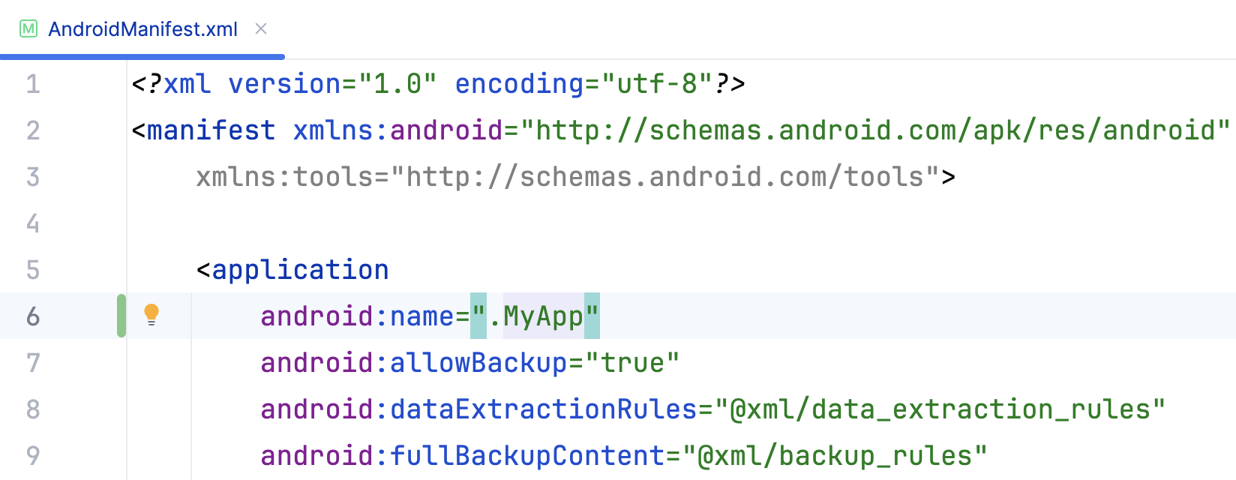
Register Application class in AndroidManifest.xml
@HiltAndroidApp class MyApp: Application()
If you miss this step:
Caused by: java.lang.IllegalStateException: Hilt Activity must be attached to an @HiltAndroidApp Application. Did you forget to specify your Application's class name in your manifest's <application />'s android:name attribute?

Slide 62
Create an Application Class
All apps that use Hilt must contain an Application class, annotated with @HiltAndroidApp.
It triggers Hilt’s code generation at compile time.
@HiltAndroidApp class MiuApp: Application()

Slide 63
Quick Start
// @AndroidEntryPoint tells Hilt that this Activity is a dependency injection entry point. // Hilt will generate code so that this Activity (and any Composables/ViewModels it uses) // can receive dependencies (like repositories, use cases, etc.) from Hilt’s graph. @AndroidEntryPoint class MainActivity : ComponentActivity() { override fun onCreate(savedInstanceState: Bundle?) { super.onCreate(savedInstanceState) enableEdgeToEdge() setContent { AlphaGameTheme { AlphabetExplorerScreen() } } } }

Slide 64
Create a Hilt module that provides a dependency for DataRepository
A Hilt module is a class that provides dependencies to the Hilt dependency injection framework.
It tells Hilt how to create instances of certain types, which can then be injected into other parts of your app.

Slide 65
Create a Hilt module that provides a dependency for Repository
// Marks this class as a Hilt module. // A module is a place where you define how to provide dependencies. @Module // Tells Hilt in which component this module will be installed. // SingletonComponent means the provided dependencies live as long as the Application. @InstallIn(SingletonComponent::class)
object RepositoryModule { @Provides fun provideAlphabetRepository(): AlphabetRepository { return AlphabetRepositoryImpl() } }
Notes:
The @Inject on the constructor tells Hilt: "I can build MyViewModel if you supply a MyRepository."
In Android, this is usually paired with @HiltViewModel and obtained via hiltViewModel() so Hilt can hook into the ViewModelFactory, but the dependency resolution works the same either way.
At compile time, Hilt’s processor scans:
Your @Inject constructors,
Your @Module classes,
Methods annotated with @Provides/@Binds,
The @InstallIn components.
The binding key is the method’s return type (MyRepository).
The binding value is whatever the method returns (MyRepositoryImpl()).
Because it’s installed in SingletonComponent, this binding is available application-wide and visible to child components (ActivityComponent, ViewModelComponent, etc.).

Slide 66
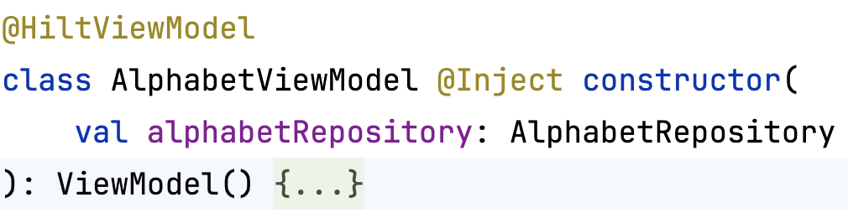
Dependency Injection for ViewModel by Hilt
@HiltViewModel
Tells Hilt how to provide instances of an Architecture Component ViewModel.
val alphabetViewModel: AlphabetViewModel = hiltViewModel()

Slide 67
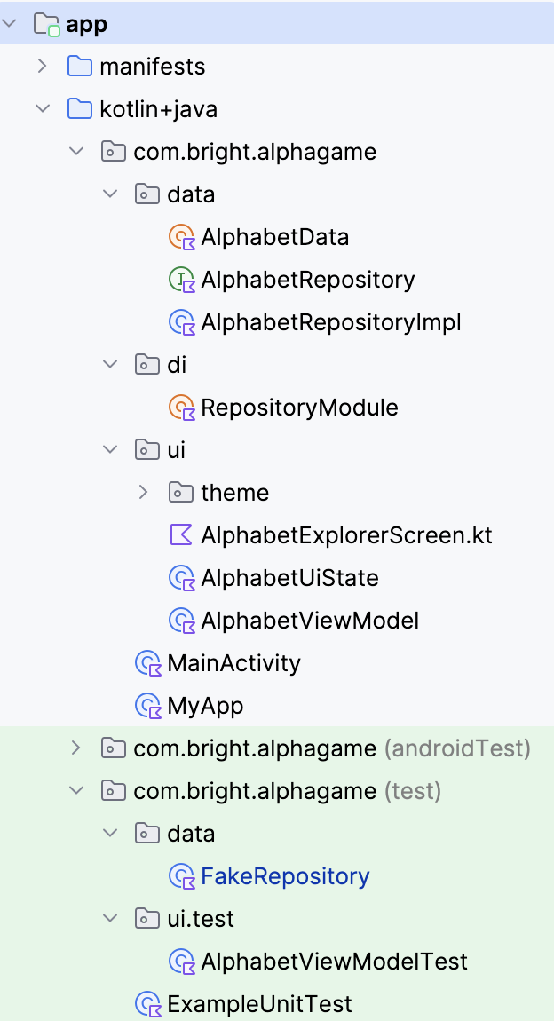
Hilt + ViewModel
https://github.com/brightgeevarghese/AlphabetExp.git

Slide 68
Another Example using Hilt

Slide 69
Quick Start
@AndroidEntryPoint class MainActivity : ComponentActivity() { @Inject lateinit var musicPlayer: MusicPlayer override fun onCreate(savedInstanceState: Bundle?) { super.onCreate(savedInstanceState) musicPlayer.playMusic() } }
1
2
1
It enables Hilt to inject dependencies into an activity.
All Hilt-injected variables will be available when super.onCreate() is called.
Hilt injects MusicPlayer in the Activity.
2
Hilt injects MusicPlayer in the Activity.

Slide 70
How does Hilt know to provide an instance of MusicPlayer?
Annotate the constructor of the class, MusicPlayer with @Inject
class MusicPlayer @Inject constructor( ) { fun playMusic( ){ /*…*/ } }

Slide 71
Manual DI
When an activity is annotated with @AndroidEntryPoint, a dependency container, say MainActivityContainer is automatically created, managed, and associated with that Activity.
//MainActivity annotated with @AndroidEntryPoint class MainActivityContainer { //MusicPlayer annotated with @Inject fun provideMusicPlayer() = MusicPlayer() }

Slide 72
Manual DI
class MainActivity : ComponentActivity() { private lateinit var container: MainActivityContainer private lateinit var musicPlayer: MusicPlayer override fun onCreate(savedInstanceState: Bundle?) { // AndroidEntryPoint does this for you container = MainActivityContainer() musicPlayer = container.provideMusicPlayer() super.onCreate(savedInstanceState) musicPlayer.playMusic() } }

Slide 73
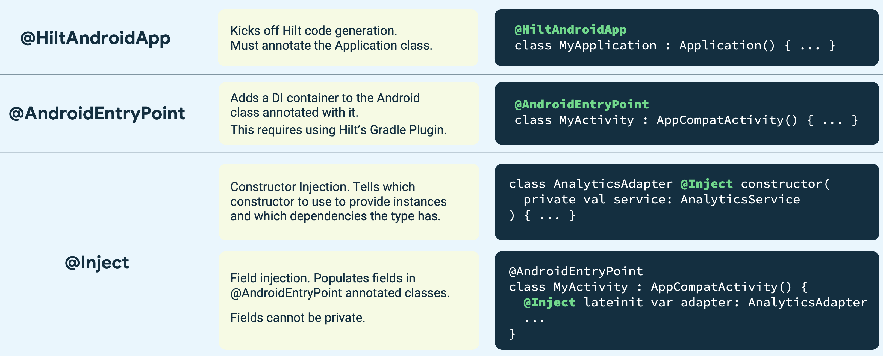
Annotations Recap
Ref: https://developer.android.com/images/training/dependency-injection/hilt-annotations.pdf

Slide 74
Inject other types
Interfaces do not have constructors, and therefore, we cannot use the @Inject annotation directly on an interface’s constructor.
Instead, provide dependencies that implement the interface using Hilt’s binding methods.
class MusicPlayer @Inject constructor( private val repository: MusicRepository ){ fun playMusic(){ /*…*/ } }
interface MusicRepository{/*...*/}

Slide 75
Manual DI
class MainActivityContainer { fun provideMusicRepository(): MusicRepository { return MusicRepositoryImpl() } fun provideMusicPlayer() = MusicPlayer( provideMusicRepository() ) }

Slide 76
Create a Hilt module that provides a dependency for DataRepository
A Hilt module is a class that provides dependencies to the Hilt dependency injection framework.
It tells Hilt how to create instances of certain types, which can then be injected into other parts of your app.

Slide 77
Create a Hilt module that provides a dependency for DataRepository
@Module @InstallIn(SingletonComponent::class) object ProgramRepositoryModule { @Provides fun provideProgramRepository(): ProgramRepository { return ProgramRepositoryImpl() } }
1
3
2
@Module annotation marks the class as a Hilt module. A module tells Hilt how to provide instances of certain types.
@InstallIn(SingletonComponent::class) specifies which Hilt component this module will be installed in
SingletonComponent ensures that dependencies provided by this module have a singleton scope, meaning they are created once and shared across the entire app.
Declaring the module as an object makes it a singleton.
This ensures that the module itself is instantiated only once, following Kotlin's singleton pattern.
Notes:
The @Inject on the constructor tells Hilt: "I can build MyViewModel if you supply a MyRepository."
In Android, this is usually paired with @HiltViewModel and obtained via hiltViewModel() so Hilt can hook into the ViewModelFactory, but the dependency resolution works the same either way.
At compile time, Hilt’s processor scans:
Your @Inject constructors,
Your @Module classes,
Methods annotated with @Provides/@Binds,
The @InstallIn components.
The binding key is the method’s return type (MyRepository).
The binding value is whatever the method returns (MyRepositoryImpl()).
Because it’s installed in SingletonComponent, this binding is available application-wide and visible to child components (ActivityComponent, ViewModelComponent, etc.).

Slide 78
Create a Hilt module that provides a dependency for DataRepository
@Module @InstallIn(SingletonComponent::class) object ProgramRepositoryModule { @Provides fun provideProgramRepository(): ProgramRepository { return ProgramRepositoryImpl() } }
@Provides annotation tells Hilt that the following method will provide a specific dependency.
Hilt will call this method to obtain an instance of the type specified.
provideProgramRepository() is a function that Hilt uses to create and provide an instance of ProgramRepository.

Slide 79
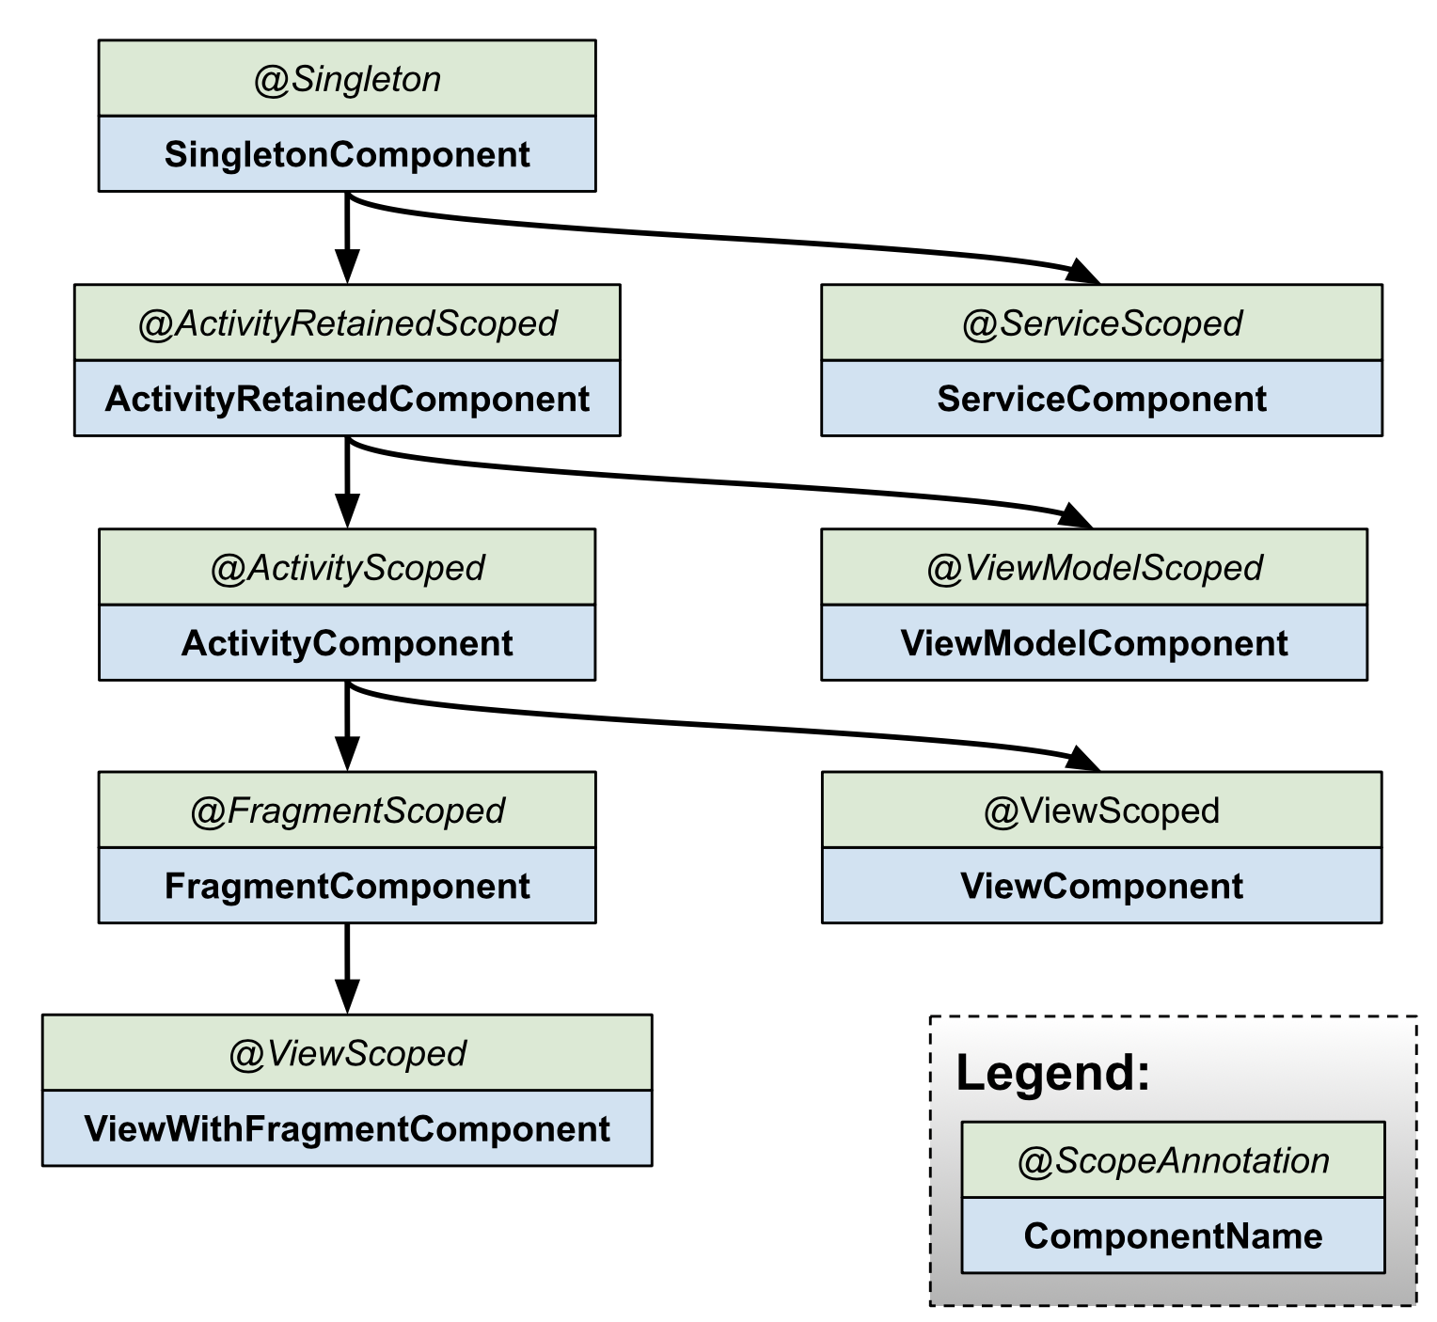
Hierarchy of the components that Hilt generates
https://developer.android.com/training/dependency-injection/hilt-android
Note:
When you use @InstallIn(SingletonComponent::class) in a Hilt module, the dependencies provided by that module are available to components that are subcomponents of the SingletonComponent.
This is the top-level component in Hilt, with a lifecycle tied to the application's lifecycle (it lives as long as the application does).

Slide 80
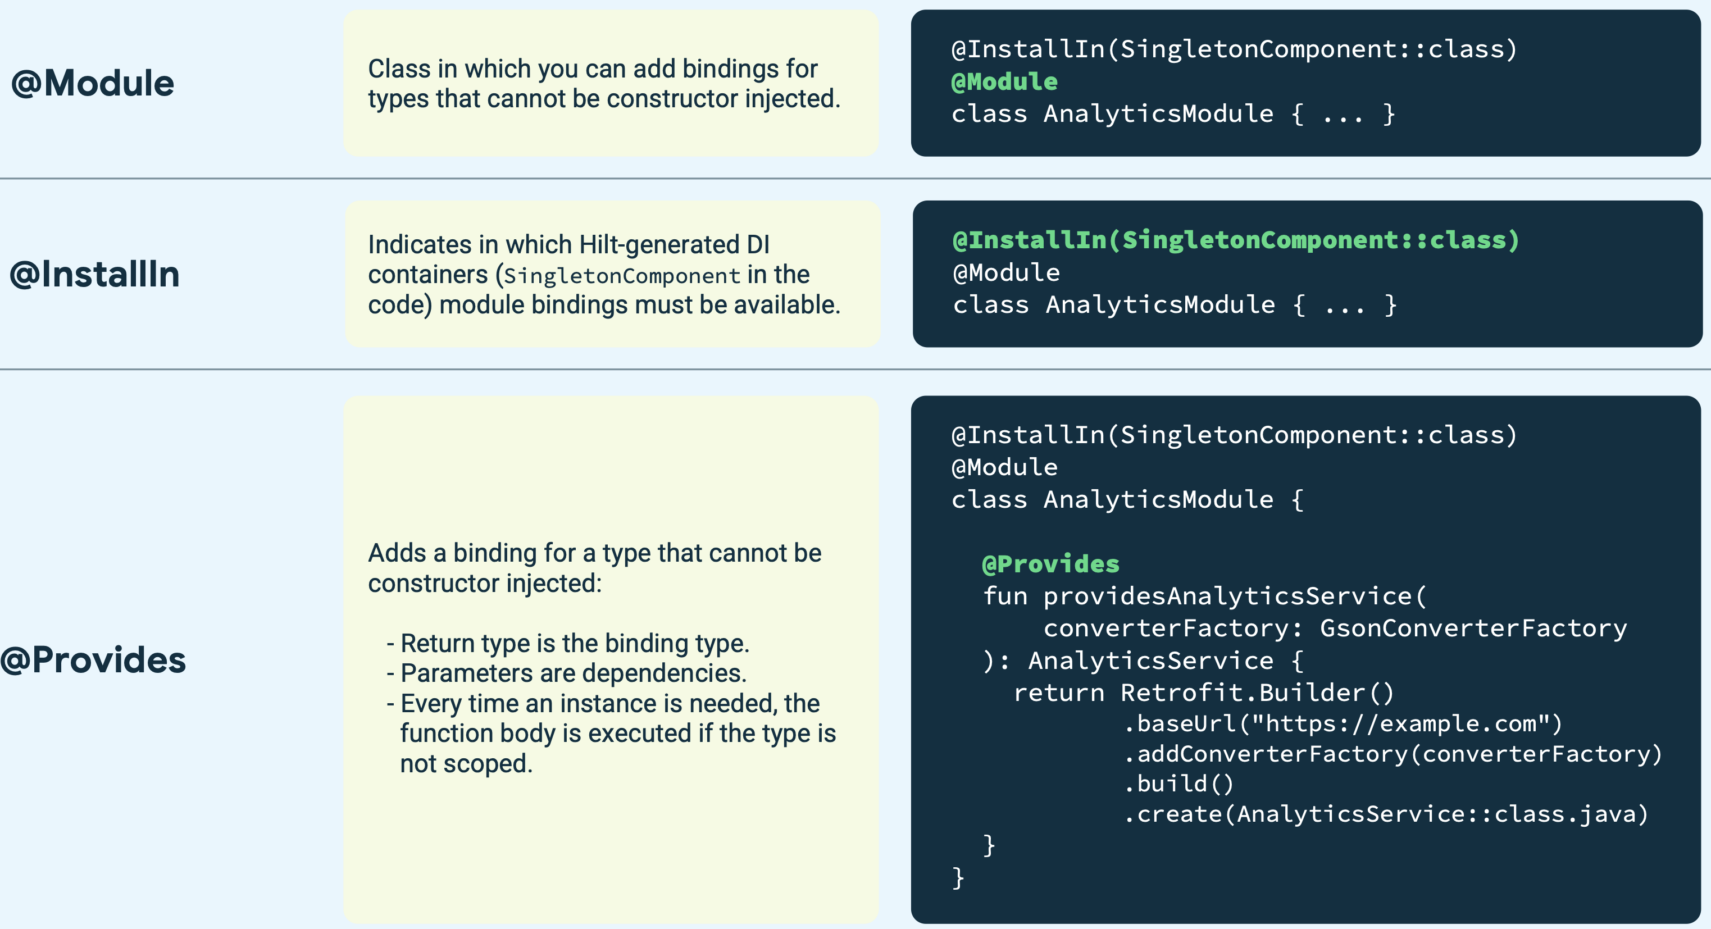
Annotations Recap
Ref: https://developer.android.com/images/training/dependency-injection/hilt-annotations.pdf

Slide 81
Dependency Injection for ViewModel by Hilt
@HiltViewModel
Tells Hilt how to provide instances of an Architecture Component ViewModel.
@HiltViewModel class SharedViewModel @Inject constructor( private val repository: MusicRepository ) : ViewModel() {/*…*/}
val sharedViewModel: SharedViewModel = hiltViewModel()

Slide 82
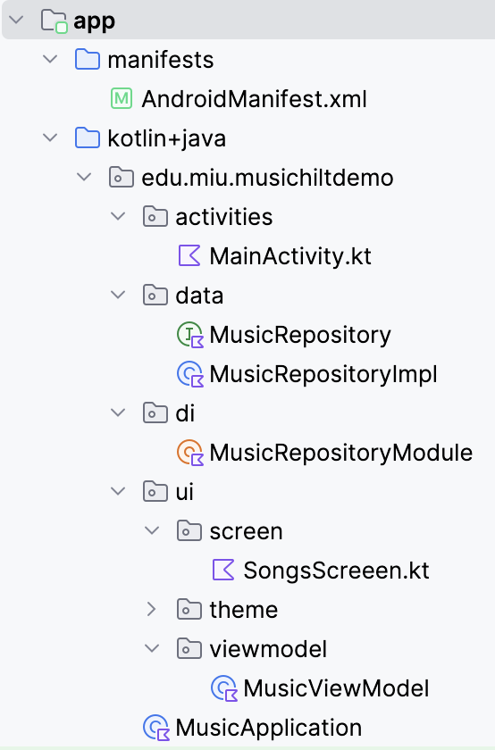
Hilt + ViewModel
https://github.com/brightgeevarghese/MusicHiltDemo.git

Slide 83

Radio Button

Slide 84
RadioButton
@Composable fun RadioButton( selected: Boolean, onClick: (() -> Unit)?, modifier: Modifier = Modifier, enabled: Boolean = true, colors: RadioButtonColors = RadioButtonDefaults.colors(), interactionSource: MutableInteractionSource? = null )

Slide 85
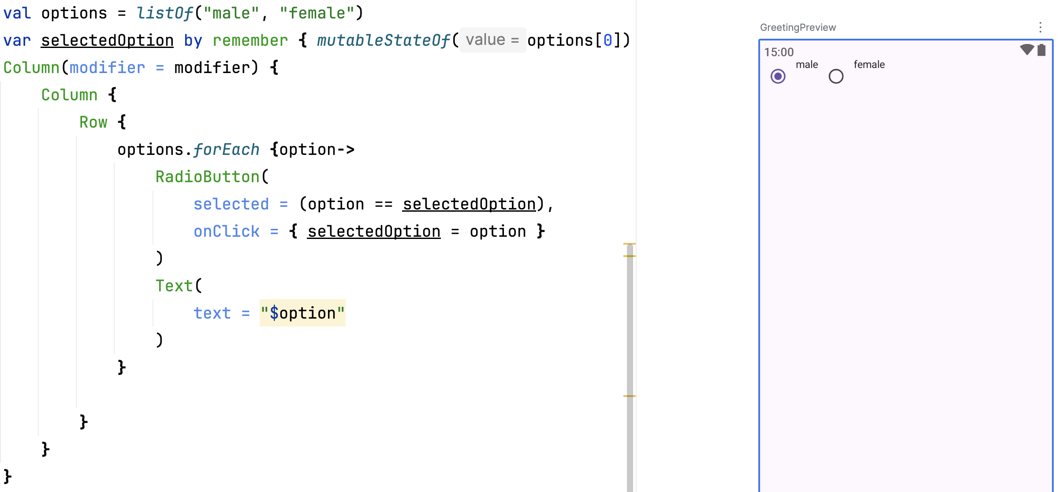
Create two RadioButton

Slide 86
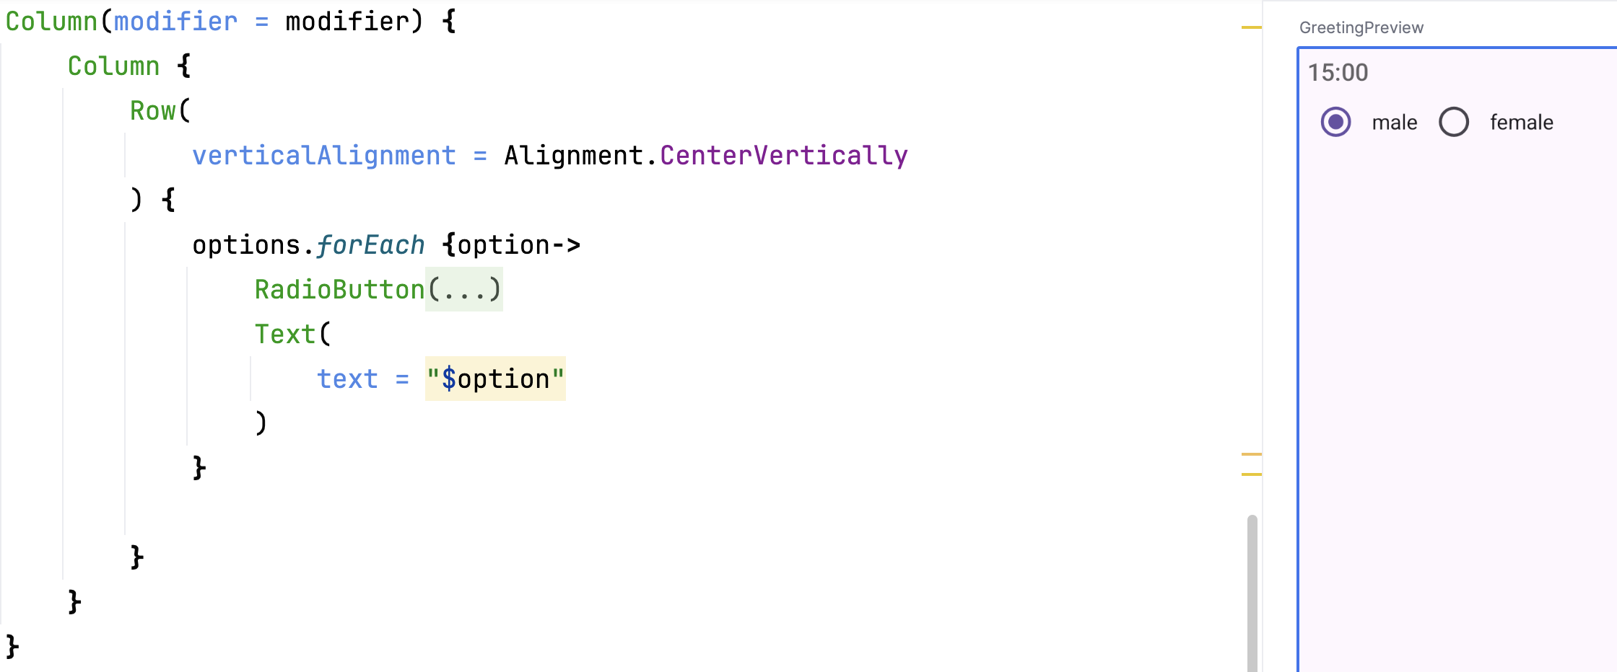
Align Center Vertically

Slide 87
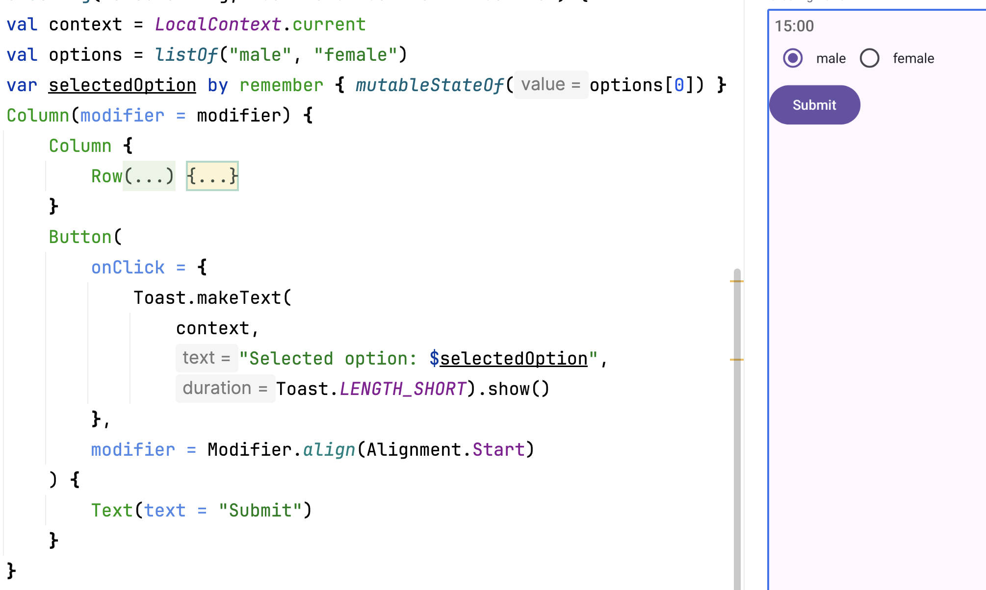
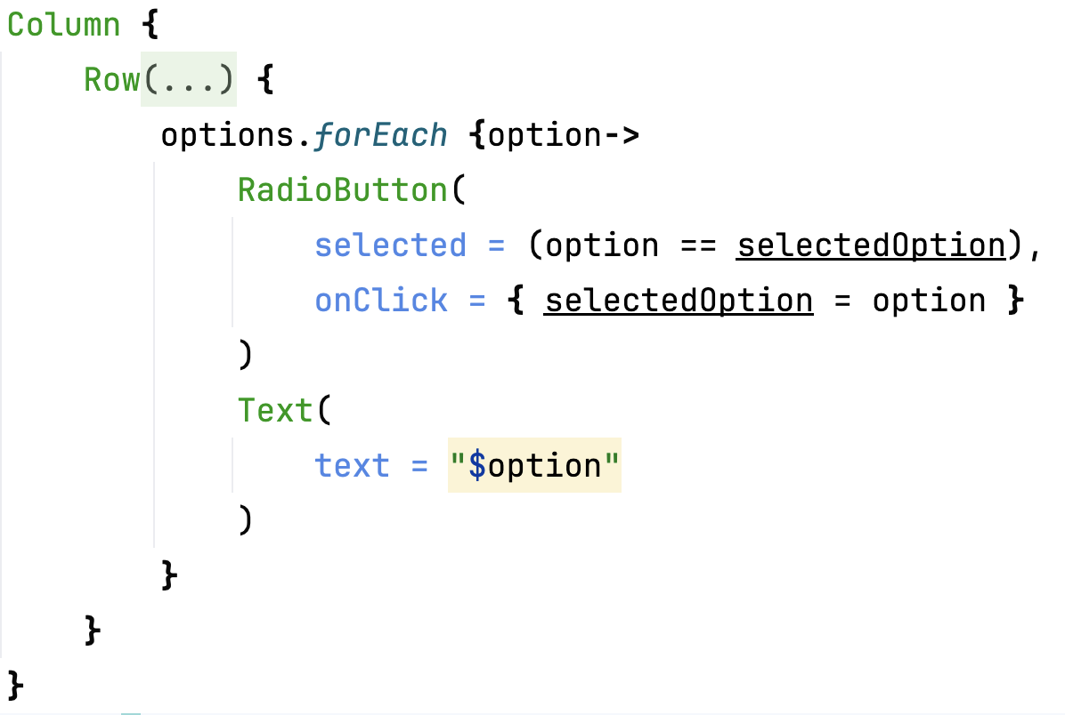
Add a Button

Slide 88

Checkbox

Slide 89
Checkbox
@Composable fun Checkbox( checked: Boolean, onCheckedChange: ((Boolean) -> Unit)?, modifier: Modifier = Modifier, enabled: Boolean = true, colors: CheckboxColors = CheckboxDefaults.colors(), interactionSource: MutableInteractionSource? = null )

Slide 90
Create a list of items for UI Hold the set of currently-selected skills.
val skills = listOf("Android", "Kotlin", "Java", "Swift") var selectedSkills by rememberSaveable { mutableStateOf(setOf<String>()) }

Slide 91
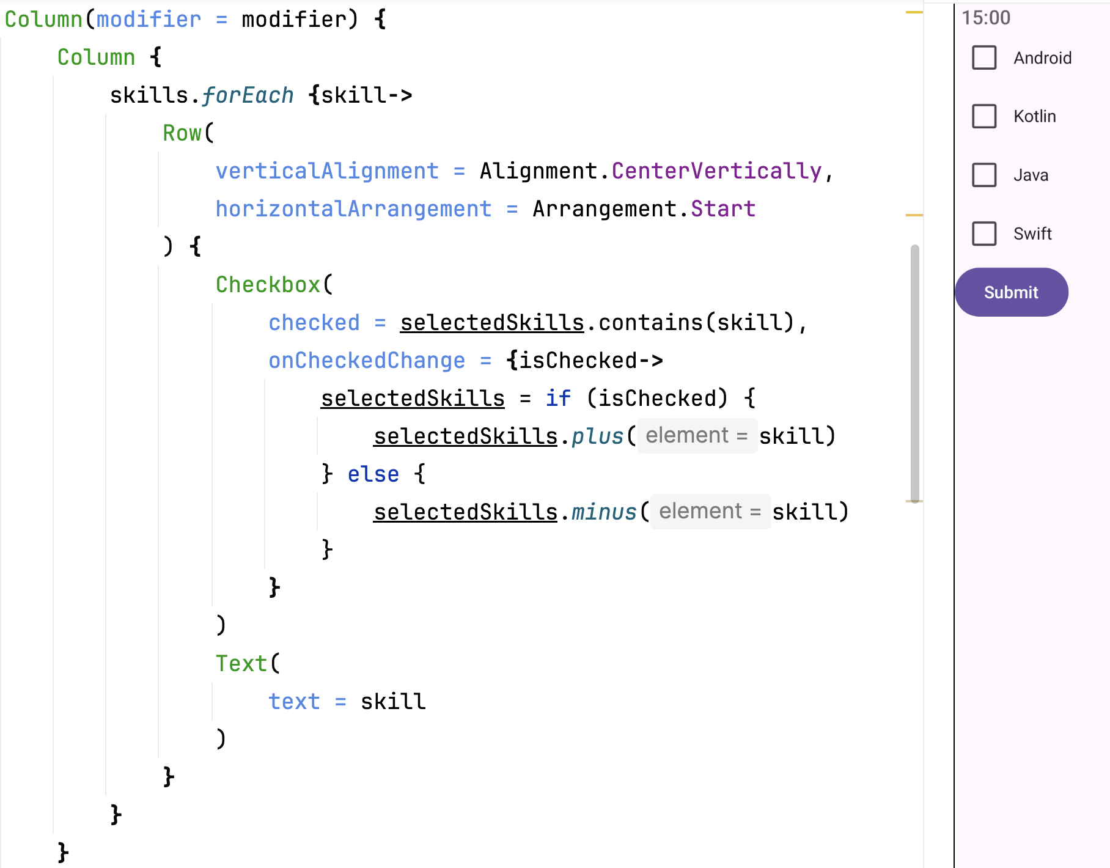
//…

Slide 92
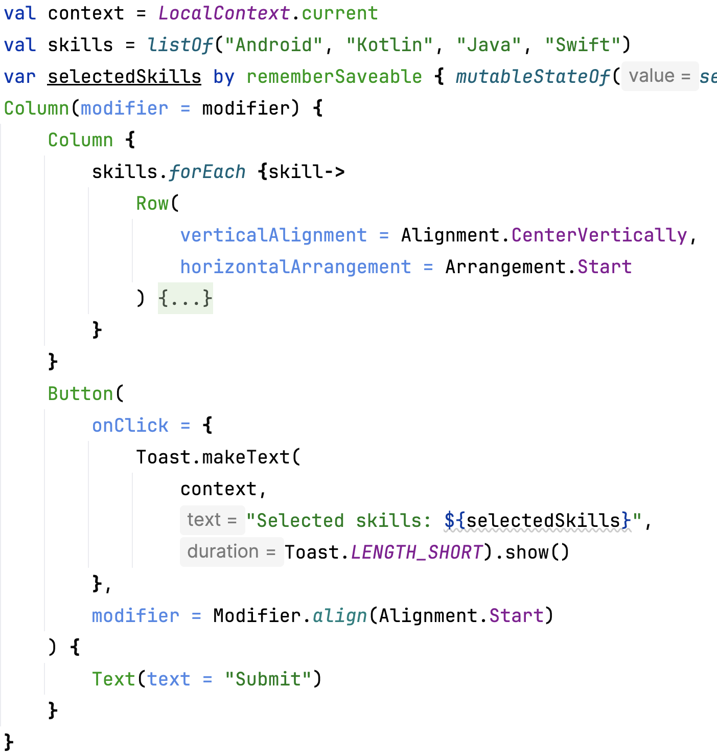
Add a Button

